Slide 1
MAT 350 Engineering Mathematics
Lecture 3B
Non-linear First Order ODE
(Bernoulli’s Equations)

Slide 3


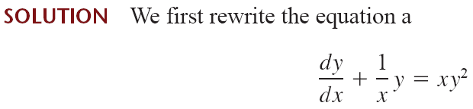





Slide 4





So a solution of the given equation is

Slide 5


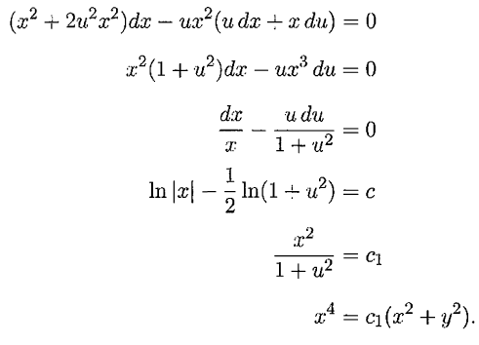
Exercise 2.5
+

Slide 6







Slide 7




Slide 8
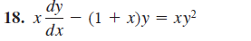
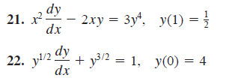
Exercise 2.5 (Zill)

